Slide 1
Calcium and Chiropractic
Darren Murphy, Tony Murray, Emma Swartling, and Stephanie Vicens

Slide 2
Learning Objectives
Know the essential functions of calcium.
Know the big three natural sources of calcium.
Learn the two most prevalent calcium supplements.
Myths, truths, and lies about the dairy.

Slide 3

Calcium

Slide 4
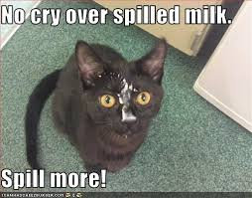
Sources of Calcium
Natural Sources
Dairy
Vegetables
Grains
Fortified Foods
http://www.whfoods.com/genpage.php?tname=nutrient&dbid=45

Slide 5
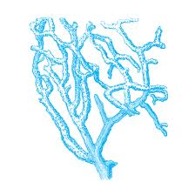
Sources of Calcium
Supplemental sources
Calcium carbonate
TUMS
Calcium citrate
http://www.webmd.com/osteoporosis/features/calcium-supplements-pills
http://well.blogs.nytimes.com/2013/04/08/thinking-twice-about-calcium-supplements-2/?_php=true&_type=blogs&_r=0

Slide 6
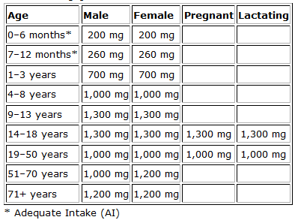
Recommended Intake

Slide 7
Absorption factors
Bioavailability
Amount of absorbable calcium in a food.
Oxalic Acid/ Phytic Acid
Inhibits calcium absorption
Vitamin D/Magnesium
Assist with absorption
Diet
Sodium, protein, caffeine, alcohol.
https://www.health.ny.gov/diseases/conditions/osteoporosis/vitamin_d_and_your_bones.htm

Slide 8
Calcium is vital for . . . . .
Muscle contractions
Secreting hormones
Sending messages through the nervous system
Blood clotting
Healthy bones and teeth!
Important to chiropractors
http://arbl.cvmbs.colostate.edu/hbooks/pathphys/endocrine/thyroid/pth.html
http://www.livestrong.com/article/464511-the-importance-of-calcium-in-muscle-contraction/

Slide 9
Pathologies related to Ca.
Blood pressure - increase or decrease
Alkalosis/Acidosis
Paget’s disease
Muscle spasms
Rickets
Neural abnormalities
Osteoporosis
Important to chiropractors!!!

Slide 10
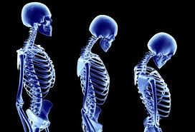
Osteoporosis

Slide 11
Osteoporosis
Risk Factors
Getting older
Being small and thin
Family history
Certain medications
White or Asian and female
http://www.nlm.nih.gov/medlineplus/osteoporosis.html
http://www.nysopep.org/

Slide 12
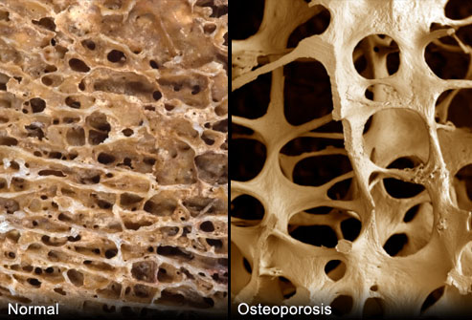
Osteoporosis
Calcium and phosphate make up the hydroxyapatite crystals which give bone it’s strength.
Low calcium in the bloodstream leeches calcium from the bones.
Bones become thinner, weaker and susceptible to fracture.
http://www.nlm.nih.gov/medlineplus/osteoporosis.html
http://www.nysopep.org/

Slide 13
What’s the most well known source of calcium?
?

Slide 14
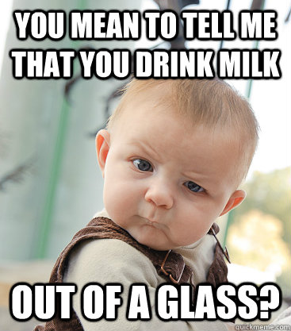
Milk!

Slide 15
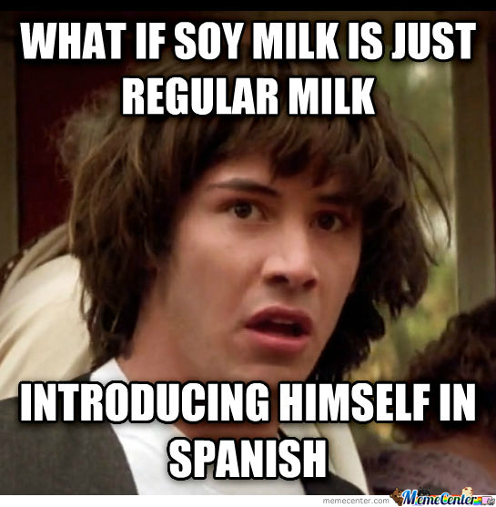
Milk!

Slide 16
The Great Milk CONSPIRACY!
Pasteurization
Mutant western milk
Calcium absorption and osteoporosis

Slide 17
Raw or Pasteurized
In the 1800’s Milk and Whiskey were processed in factories side by side.
The milk cows were fed the spent whiskey “hot slop”.
The conditions were often filthy, some milk was dyed white with chalk to hide discoloration in rancid product.
Pasteurization “solved” the problem.

Slide 18
Where are we now?
Although raw and pasteurized milk were competitors from 1910 – 1940, pasteurization eventually became the norm.
Raw milk is still illegal in 22 states and cannot be sold across state lines.

Slide 19
FDA’s and CDC’s advice:
Raw milk is dangerous.
CDC study included 121 raw dairy–related disease outbreaks, which caused 4,413 illnesses, 239 hospitalizations and three deaths over 13 years.
CDC estimates that each year roughly 1 in 6 Americans gets sick, 128,000 are hospitalized, and 3,000 die of all foodborne diseases.
http://www.cdc.gov/media/releases/2012/p0221_raw_milk_outbreak.html

Slide 20
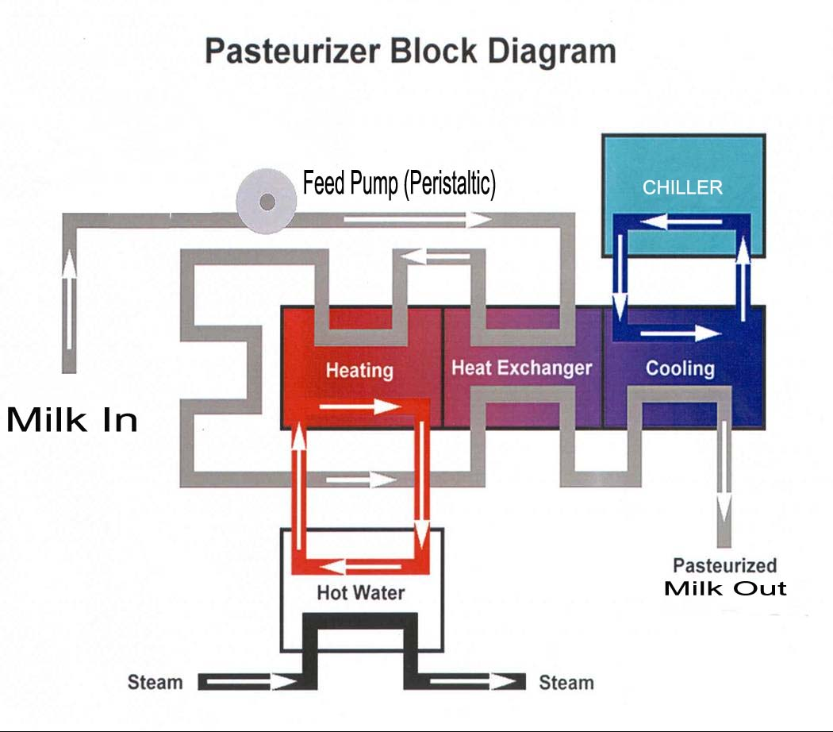
Milk Pasteurization Process
In the HTST (high temperature short time) process, milk is forced between metal plates or through pipes heated on the outside by hot water, and is heated to 72°C (161°F) for 15 seconds.
UHT (ultra high temperature) processing holds the milk at a temperature of 138°C (280°F) for a minimum of two seconds.

Slide 21
What does pasteurization do?
Study: Microbiological profile of milk: impact of household practices. Agarwal A¹, Awasthi V, Dua A, Ganguly S, Garg V, Marwaha SS.
Milk samples of pasteurized, ultra heat treated (UHT) as well as unpasteurized milk (Vendor's milk) were collected
Conclusion: The pasteurization process and hygienic conditions at the milk processing units along with cold chain of milk from suppliers to end users needs improvement. Currently, even pasteurized milk does not match the microbiological standards.

Slide 22
Raw Milk and Lactose Intolerance
Weston A. Price Michigan raw milk survey:
Summer of 2007, Households that obtain fresh unprocessed milk from Cowshare Dairies in Michigan and several adjacent areas.
731 completed surveys were returned by mail and analyzed. The households included 2,503 people
6% of people reported lactose intolerance.
Of these, 81% report that they are able to drink fresh unprocessed milk without the symptoms.

Slide 23
Stanford Raw Milk Study
16 lactose intolerant subjects.
Soy, raw, and pasteurized milk all flavored the same.
8 days with a random milk each day.
Similar symptoms with raw and pasteurized milk.
Effect of Raw Milk on Lactose Intolerance Symptoms: A Randomized Controlled Trial. Quyen Vu & Sarah Mummah, Mentor: Dr. Christopher Gardner
http://nutrition.stanford.edu/projects/RawMilkStudy.html

Slide 24
Mutant Milk: A1 vs. A2
Milk that contains A1 beta-casein is commonly known as A1 milk
Milk that does not is called A2.
Most milk in western countries is A1.
Devil in the Milk: Illness, Health and the Politics of A1 and A2 Milk. Keith Woodford (Author)

Slide 25
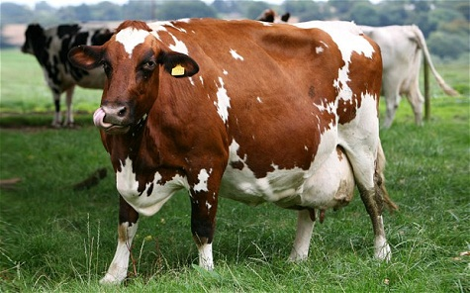
BCM7 Protein
BCM7 is a powerful opiate that can have a very detrimental impact on your body.
A2 Milk holds on to BCM7 while A1 milk sets it free in our digestive tracts.
Mutant cow
Devil in the Milk: Illness, Health and the Politics of A1 and A2 Milk. Keith Woodford (Author)

Slide 26
A1 Milk Issues
BCM 7 selectively binds to the epithelial cells in mucus membranes and stimulates mucus secretion.
BCM7 has also been implicated in other far more serious health problems:
• Type 1 diabetes • Neurological impairment, including
autism and schizophrenia • Impaired immune function • Autoimmune disease • Heart disease
Devil in the Milk: Illness, Health and the Politics of A1 and A2 Milk. Keith Woodford (Author)

Slide 27
Does milk increase mucus production?
Bartley J¹, McGlashan SR.
Author information
Abstract
Excessive milk consumption has a long association with increased respiratory tract mucus production and asthma. Such an association cannot be explained using a conventional allergic paradigm and there is limited medical evidence showing causality. In the human colon, beta-casomorphin-7 (beta-CM-7), an exorphin derived from the breakdown of A1 milk, stimulates mucus production from gut MUC5AC glands. In the presence of inflammation similar mucus overproduction from respiratory tract MUC5AC glands characterises many respiratory tract diseases. beta-CM-7 from the blood stream could stimulate the production and secretion of mucus production from these respiratory glands. Such a hypothesis could be tested in vitro using quantitative RT-PCR to show that the addition of beta-CM-7 into an incubation medium of respiratory goblet cells elicits an increase in MUC5AC mRNA and by identifying beta-CM-7 in the blood of asthmatic patients. This association may not necessarily be simply cause and effect as the person has to be consuming A1 milk, beta-CM-7 must pass into the systemic circulation and the tissues have to be actively inflamed. These prerequisites could explain why only a subgroup of the population, who have increased respiratory tract mucus production, find that many of their symptoms, including asthma, improve on a dairy elimination diet.

Slide 28
Framingham Study
Study consisted of 907 63-93 yr old subjects.
Monitored for 12 years.
Bone mineral density (BMD) at femoral neck was compared to diet.
Dietary patterns were broken down into six bulk patterns
Meat, dairy, and bread;
Meat and sweet baked products;
Sweet baked products;
Alcohol;
Candy;
and fruit, vegetables, and cereal.
The Framingham Osteoporosis Study 1–3. Katherine L Tucker, Honglei Chen, Marian T Hannan, L Adrienne Cupples, Peter WF Wilson, David Felson, and Douglas P Kiel

Slide 29
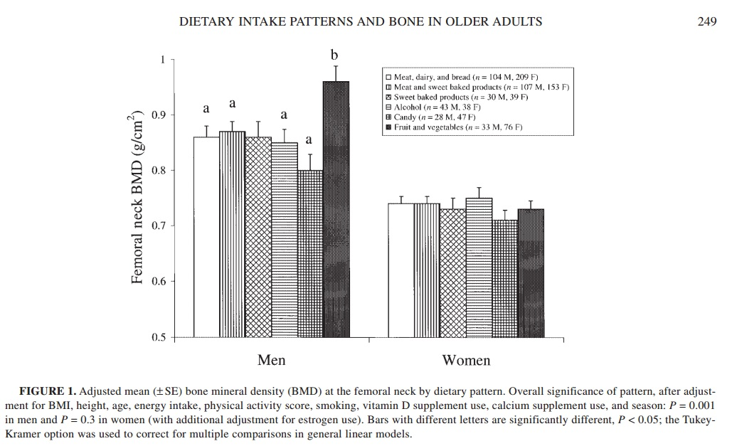
Bone mineral density and dietary patterns in older adults:
the Framingham Osteoporosis Study1 – 3
Katherine L Tucker, Honglei Chen, Marian T Hannan, L Adrienne Cupples, Peter WF Wilson, David Felson, and Douglas P Kiel

Slide 30
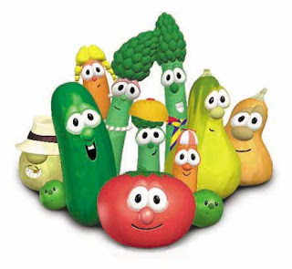
Bottom line:
Vegetables are better for your bones than dairy, if you’re a man.
Candy is worse for your bones than dairy.

Slide 31
What is the mutated western milk called?
A2
PU
A1
M1

Slide 32
Calcium aids in . . .
Muscle contraction
Nervous system messaging.
Hormonal Secretion
All of the above.

Slide 33
Which of the following is not a significant source of calcium?
Dairy
Fruit
Grains
Vegetables

Slide 34
Conclusion
Calcium is imperative for proper body function.
Calcium can be found in natural and supplemental sources.
Calcium absorption can be affected by diet, nutrients, and lifestyle.
Dairy is not the powerhouse calcium source the government wants you to think it is.

Slide 35
References
http://arbl.cvmbs.colostate.edu/hbooks/pathphys/endocrine/thyroid/pth.html
http://www.livestrong.com/article/464511-the-importance-of-calcium-in-muscle-contraction/
http://www.nlm.nih.gov/medlineplus/osteoporosis.html
Microbiological profile of milk: impact of household practices. Agarwal A¹, Awasthi V, Dua A, Ganguly S, Garg V, Marwaha SS.
The Framingham Osteoporosis Study 1–3. Katherine L Tucker, Honglei Chen, Marian T Hannan, L Adrienne Cupples, Peter WF Wilson, David Felson, and Douglas P Kiel
Does milk increase mucus production? Bartley J¹, McGlashan SR.
Devil in the Milk: Illness, Health and the Politics of A1 and A2 Milk. Keith Woodford (Author)
Effect of Raw Milk on Lactose Intolerance Symptoms: A Randomized Controlled Trial. Quyen Vu & Sarah Mummah, Mentor: Dr. Christopher Gardner
Weston A. Price Michigan raw milk survey
http://www.nysopep.org/
https://www.health.ny.gov/diseases/conditions/osteoporosis/vitamin_d_and_your_bones.htm
http://ods.od.nih.gov/factsheets/Calcium-HealthProfessional/
http://www.webmd.com/vitamins-supplements/ingredientmono-781-CALCIUM.aspx?activeIngredientId=781&activeIngredientName=CALCIUM
http://well.blogs.nytimes.com/2013/04/08/thinking-twice-about-calciumsupplements-2/?_php=true&_type=blogs&_r=0
http://www.nlm.nih.gov/medlineplus/ency/article/007477.htm
http://www.webmd.com/osteoporosis/features/calcium-supplements-pills
http://orthopedics.about.com/od/osteoporosistreatment/f/calciumtype.htm
http://articles.mercola.com/sites/articles/archive/2012/01/30/calcium-supplementon-heart-attack.aspx
https://www.health.ny.gov/diseases/conditions/osteoporosis/Calcium_supplements.htm
http://ods.od.nih.gov/factssheets/Calcium-QuickFacts/
http://www.whfoods.com/genpage.php?tname=nutrient&dbid=45
http://lpi.oregonstate.edu/infocenter/minerals/calcium/
http://greatist.com/health/18-surprising-dairy-free-sources-calcium
http://www.hsph.harvard.edu/nutritionsource/calcium-sources/
http://www.nlm.nih.gov/medlineplus/ency/article/002412.htm
http://www.vrg.org/nutrition/calcium.php
http://www.foodproductiondesign.com/articles/1998/05/boning-up-on-calcium-fortification.aspx

